Slide 1
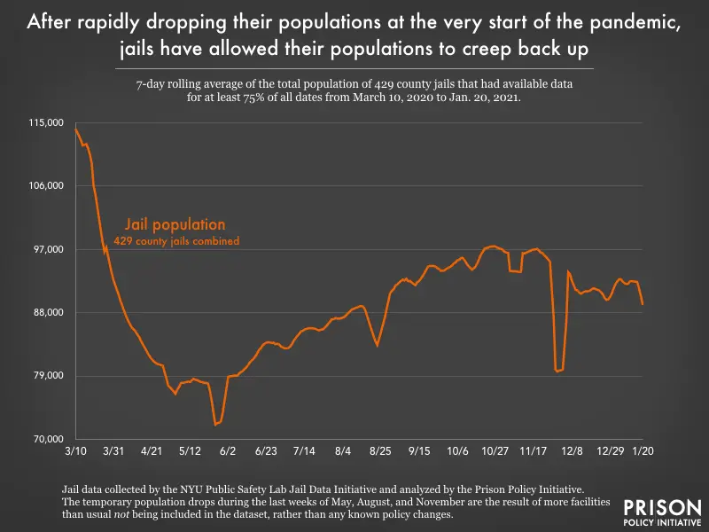
1

Slide 2
Source
https://www.prisonpolicy.org/blog/2021/02/03/january-population-update/
2

